Slide 1
Genetic Algorithm
Trevor Corbin

Slide 2
Refresher
Genetic Algorithm
Algorithm that simulates natural selection and evolution
Feed the program a string, program generates random string
Evolves through crossover and mutation to arrive at goal
Major project goal is to increase speed at which program arrives at its goal
Achieve this through parallelization of program functions

Slide 3
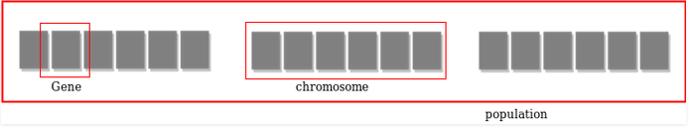
How the Algorithm Works
Population of individuals is created
Individual is built of genes (characters) to have a chromosome (string of characters) and has a fitness score (how close it is to the target)
Program started with 100, I changed it to 1,000,000 individuals
Enters while loop that runs until correct string is found
Sort population by fitness score (lower score = better)
Individual with best fitness score is the representative for that population
Top 10% of initial population move on to the next population (100,000 individuals per population from here on out)

Slide 4
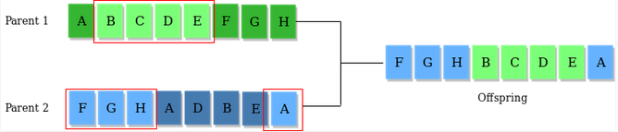
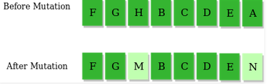
How the Algorithm Works cont.
Top 50% of the next population mate to produce offspring
Two random individuals are selected to crossover
Generates random number for probability
Iterates through each character in the two individuals
If probability is less than 0.45, insert character from Parent 1 to offspring
If probability is between 0.45 and 0.90, insert character from Parent 2 to offspring
If probability is more than 0.90, insert random character to offspring
Add offspring to new population
Runs through this process until it arrives at target string

Slide 5
Initial Ideas to Improve Speed
Parallelize any and all functions
Create initial population
Create new generation
Calculate fitness
Crossover
Mutate genes

Slide 6
Steps to Improve - Failure
Results with everything parallelized were abysmal
Program took at least 5x longer to execute
Initializing thousands of threads threads every second brought program to a halt
More threads =/= better
Calculating fitness, crossover, and mutation had very little impact on performance
Trying to parallelize this just made thing worse

Slide 7
Steps to Improve - Success
Focus on parallelizing what is actually time consuming
Creating initial and next populations
Create two individuals at a time and add both to population
Iterate through loop half the number of times
10% increase to threaded speed
Release & Visual Studio Debugger vs Debug & Powershell
For most of project, did testing in Powershell built as Debug
Last minute decided to build program in Release and run in Visual Studio Debugger
Saw 15% increase in speed for unthreaded vs threaded
Overall runtime in Release is ¼ of Debug runtime

Slide 8
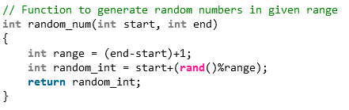
Steps to Improve - Success
Fix issue with original code
Returned random probability as an int and not a float (could only return 0 or 1)
Program would only add character from Parent 1 or a random character
Doubled the number of generations needed
After fixing issue:
10% increase to threaded performance
Halved program runtime

Slide 9
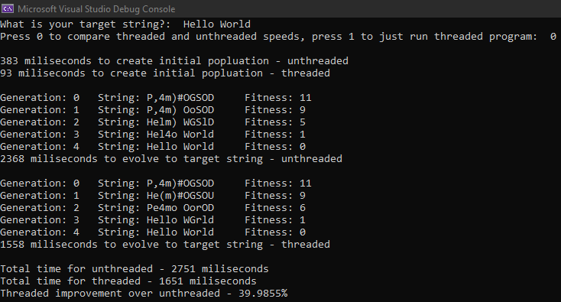
The Numbers
Target string: High Performance
Unthreaded execution time: 7450 milliseconds
Threaded execution time: 5768 milliseconds
Improvement: 22.58%
Target string: Mid-Hi-Test
Unthreaded execution time: 2769 milliseconds
Threaded execution time: 1623 milliseconds
Improvement: 41.39%

Slide 10
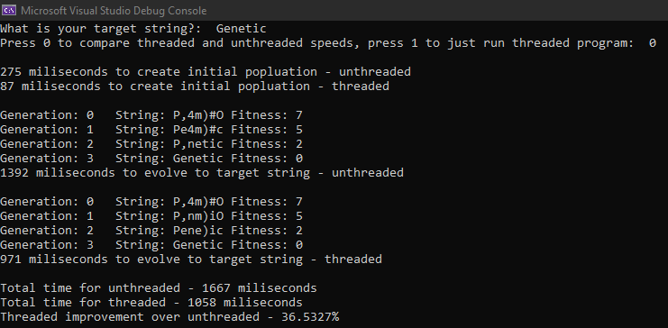
The Numbers cont.
Target string: Mid-Test
Unthreaded execution time: 1805 milliseconds
Threaded execution time: 1145 milliseconds
Improvement: 36.57%
Target string: Tester
Unthreaded execution time: 2315 milliseconds
Threaded execution time: 1476 milliseconds
Improvement: 36.24%

Slide 11
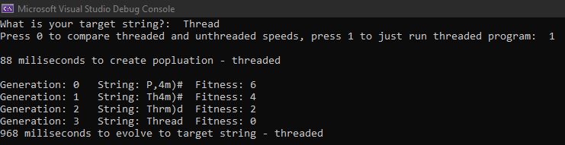
The Numbers cont.
Target string: Test
Unthreaded execution time: 920 milliseconds
Threaded execution time: 646 milliseconds
Improvement: 29.78%
Average improvement: 33.31%

Slide 12
Final Thoughts
Better grasp of threading programs
More threads =/= better
Good opportunities for multi-threading
Identify program bottlenecks
Multi-threading can be fun

